Slide 1
Data Mining
Practical Machine Learning Tools and Techniques
Extending instance-based and linear models
Notes:
4/16/2020
1
1

Slide 2
Extending instance-based learning and linear models
Instance-based learning
Pruning and reducing the number of exemplars
Weighted attributes
Generalized exemplars and distance functions
Extending linear models
Support vector machines, kernel ridge regression, kernel perceptrons
Multilayer perceptrons and radial basis function networks
Gradient descent
Numeric prediction with local linear models
Model Trees
Learning rule sets with model trees
Locally weighted linear regression
Notes:
4/16/2020
2
2

Slide 3
Instance Based Learning

Slide 4
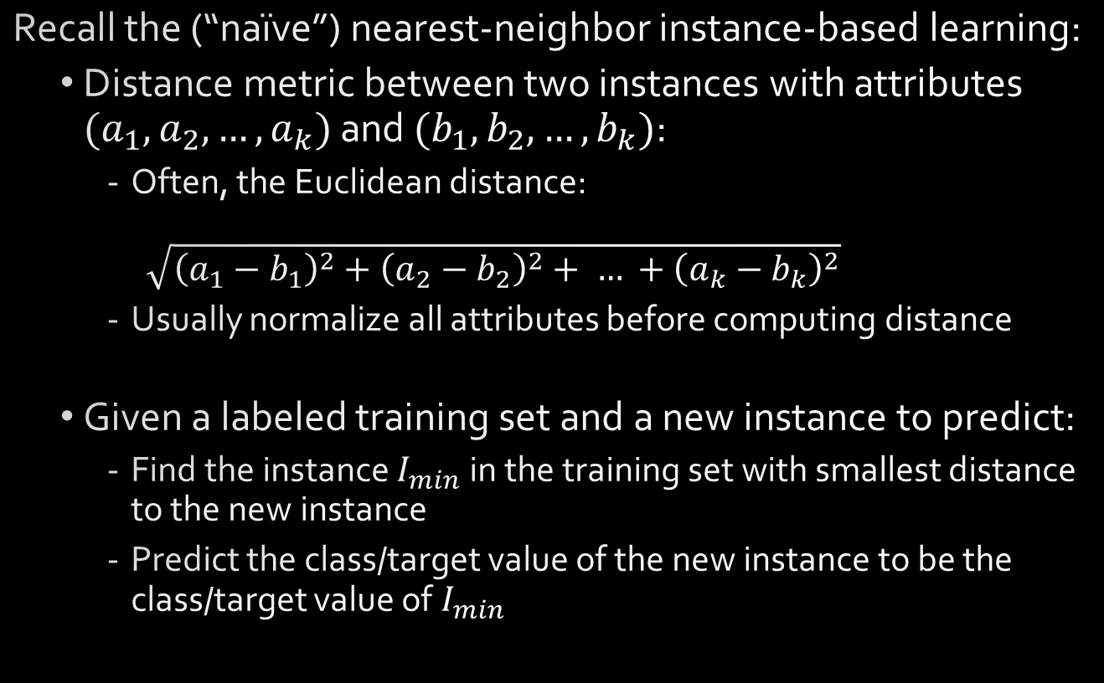
Nearest-neighbor Instance-based learning
Recall the (“naïve”) nearest-neighbor instance-based learning:
Distance metric between two instances with attributes $(a_{1},a_{2}, …, a_{k})$ and $(b_{1}, b_{2}, …, b_{k})$:
Often, the Euclidean distance: $\sqrt{{\left(a_{1}−b_{1}\right)}^{2}+{\left(a_{2}−b_{2}\right)}^{2}+ … +{\left(a_{k}−b_{k}\right)}^{2}}$
Usually normalize all attributes before computing distance
Given a labeled training set and a new instance to predict:
Find the instance $I_{min}$ in the training set with smallest distance to the new instance
Predict the class/target value of the new instance to be the class/target value of $I_{min}$
Notes:
4/16/2020
4
4

Slide 5
Instance-based learning
Practical problems of 1-nearest-neighbour scheme:
Slow (but: fast tree-based approaches exist)
- Remedy: remove irrelevant data
Noise (but: k -NN copes quite well with noise)
- Remedy: remove noisy instances
All attributes deemed equally important
- Remedy: weight attributes
Doesn’t perform explicit generalization
- Remedy: rule-based NN approach
Notes:
4/16/2020
5
5

Slide 6
Learning prototypes
Only those instances involved in a decision need to be stored
Noisy instances should be filtered out
Idea: only use prototypical examples
Notes:
4/16/2020
6
6

Slide 7
Speed up classification, combat noise
David Aha’s IB2: save memory, speed up classification
Work incrementally
Only incorporate misclassified instances
Problem: noisy data gets incorporated
David Aha’s IB3: deal with noise
Discard instances that do not perform well
Compute confidence intervals for
1. Each instance’s success rate (= s/n)
2. Default accuracy of the instance’s class (= c/N)
Accept/reject instances according to performance
1. Accept if lower limit of 1 exceeds upper limit of 2
2. Reject if upper limit of 1 is below lower limit of 2
Notes:
4/16/2020
7
7

Slide 8
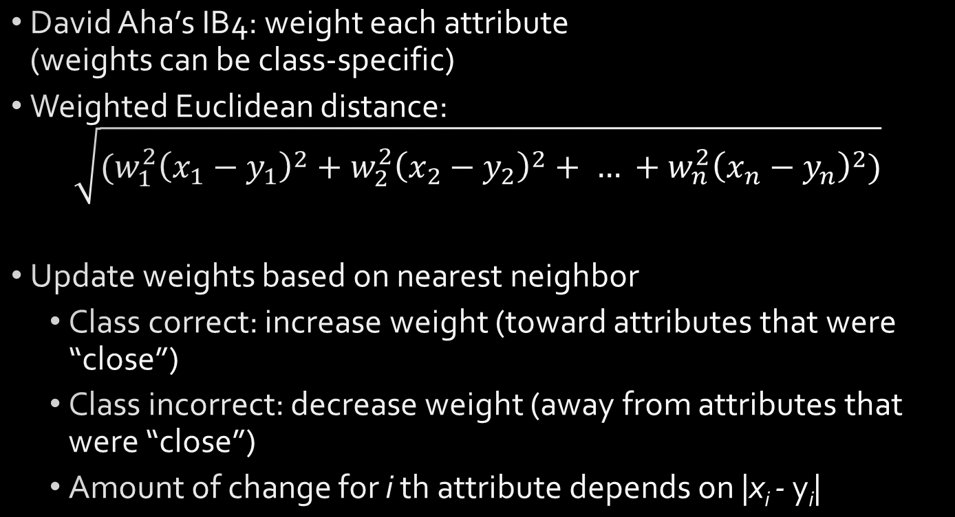
Weight attributes
David Aha’s IB4: weight each attribute (weights can be class-specific)
Weighted Euclidean distance: $\sqrt{(w_{1}^{2}{\left(x_{1}−y_{1}\right)}^{2}+w_{2}^{2}{\left(x_{2}−y_{2}\right)}^{2}+ … +w_{n}^{2}{\left(x_{n}−y_{n}\right)}^{2})}$
Update weights based on nearest neighbor
Class correct: increase weight (toward attributes that were “close”)
Class incorrect: decrease weight (away from attributes that were “close”)
Amount of change for i th attribute depends on |x_{i} - y_{i}|
Notes:
4/16/2020
8
8

Slide 9
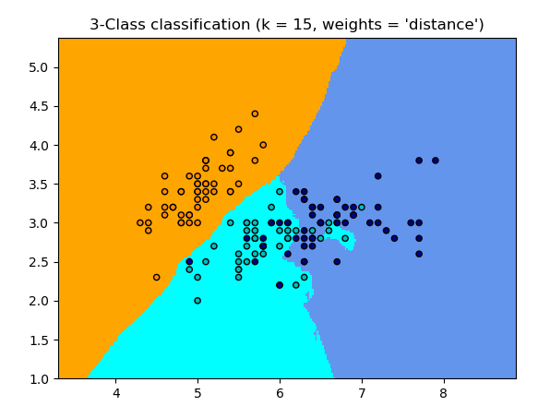
k-NN Classifier Example
k-NN (k=15)
- “Iris” dataset
- 2 features
- 3 classes
Source: https://scikit-learn.org/stable/auto_examples/neighbors/plot_classification.html
Notes:
4/16/2020
9
9

Slide 10
Generalized exemplars
Generalize instances into hyperrectangles
Online: incrementally modify rectangles
Offline version: seek small set of rectangles that cover the instances
Important design decisions:
Allow overlapping rectangles?
Requires conflict resolution
Allow nested rectangles?
Dealing with uncovered instances?
Notes:
4/16/2020
10
10

Slide 11
Rectangular generalizations
Nearest-neighbor rule is used outside rectangles
Rectangles are rules! (But they can be more conservative than “normal” rules.)
Nested rectangles are rules with exceptions
Notes:
4/16/2020
11
11

Slide 12
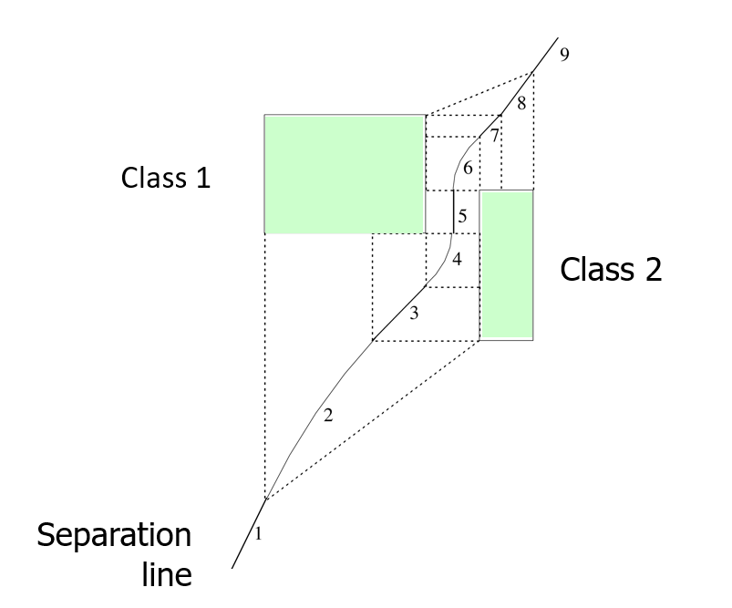
Separating generalized exemplars
Notes:
4/16/2020
12
12

Slide 13
Generalized distance functions
Problem with Euclidean distance, etc.: only natural for purely numeric datasets
Transformation-based approach to designing distance functions can be applied more generally
Given: some transformation operations on attributes
K* similarity = probability of transforming instance A into B by chance
Average over all transformation paths
Weight paths according their probability (need way of measuring this)
Easily generalized to give distance between sets of instances
Notes:
4/16/2020
13
13

Slide 14
Discussion and Bibliographic Notes
Nearest-neighbor methods gained popularity in machine learning through the work of Aha (1992)
Salzberg (1991) suggested that generalization with nested exemplars can achieve high classification accuracy
Wettschereck and Dietterich (1994) argued that these results were fortuitous and did not hold in other domains
Martin (1995) explored the idea that overgeneralization that occurs when hyperrectangles nest or overlap is problematic
The generalized distance function based on transformations is described by Cleary and Trigg (1995)

Slide 15
Extending Linear Models

Slide 16
Support vector machines
Support vector machines are algorithms for learning linear classifiers
Resilient to overfitting because they learn a particular linear decision boundary:
The maximum margin hyperplane
Fast in the nonlinear case
Use a mathematical trick to avoid creating “pseudo-attributes”
The nonlinear space is created implicitly
Notes:
4/16/2020
16
16

Slide 17
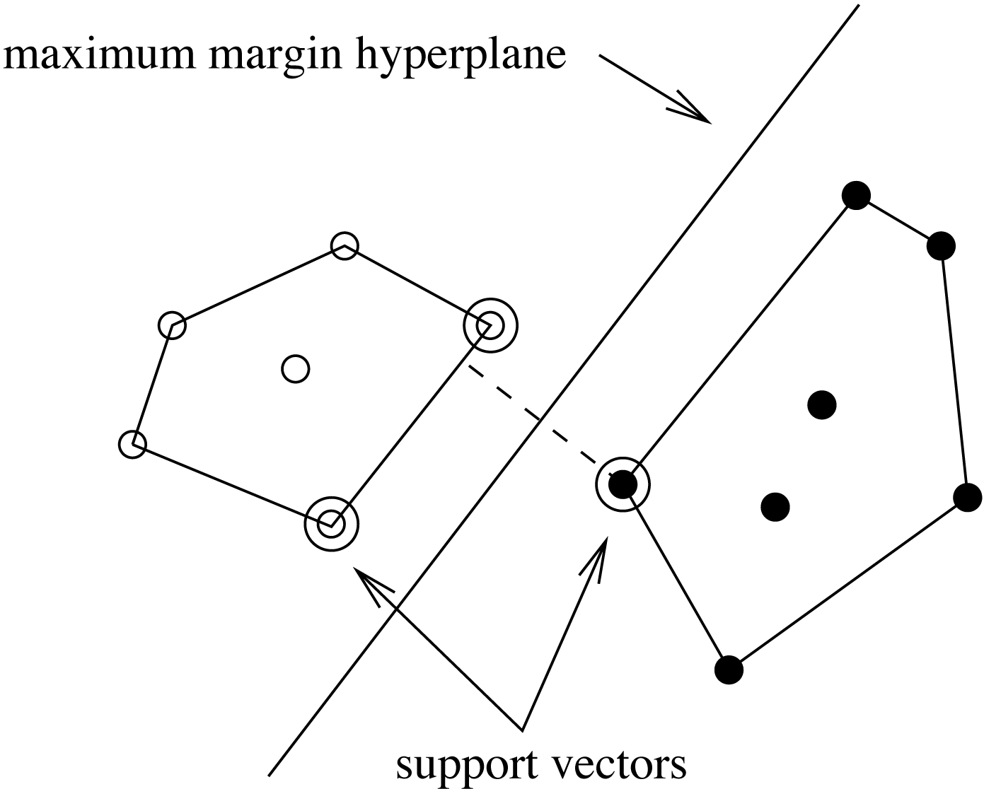
The maximum margin hyperplane
The instances closest to the maximum margin hyperplane are called support vectors
Notes:
4/16/2020
17
17

Slide 18
Support vectors
The support vectors define the maximum margin hyperplane
All other instances can be deleted without changing its position and orientation
The hyperplane
can be written as
Notes:
4/16/2020
18
18

Slide 19
Finding support vectors
Support vector: training instance for which α_{i} > 0
Determining α_{i} and b ?— A constrained quadratic optimization problem
Off-the-shelf tools for solving these problems
However, special-purpose algorithms are faster
Example: Platt’s sequential minimal optimization (SMO) algorithm
Note: the method discussed so far assumes separable data!
Notes:
4/16/2020
19
19

Slide 20
Nonlinear SVMs
We can create a nonlinear classifier by creating new “pseudo” attributes from the original attributes in the data
“Pseudo” attributes represent attribute combinations
E.g.: all polynomials of degree 2 that can be formed from the original attributes
We can learn a linear SVM from this extended data
The linear SVM in the extended space is a non-linear classifier in the original attribute space
Overfitting often not a significant problem with this approach because the maximum margin hyperplane is stable
There are often comparatively few support vectors relative to the size of the training set
Computation time still an issue
Each time the dot product is computed, all the “pseudo attributes” must be included
Notes:
4/16/2020
20
20

Slide 21

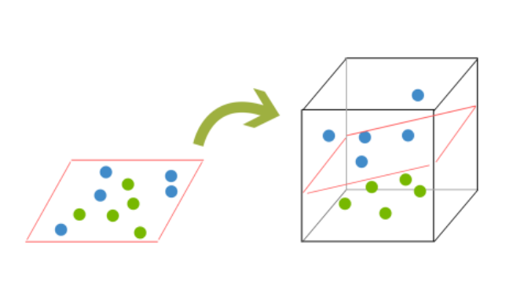
SVM: Visual Example
Two classes; NOT Linearly Separable!
Map to higher dimension; now SEPARABLE!
Image Source: https://www.kdnuggets.com/2016/07/support-vector-machines-simple-explanation.html
Notes:
4/16/2020
21
21

Slide 22
A mathematical trick
Avoid computing the “pseudo attributes”
Compute the dot product before doing the nonlinear mapping
Example:
Corresponds to a map into the instance space spanned by all products of n attributes
Notes:
4/16/2020
22
22

Slide 23
Other kernel functions
Mapping is called a “kernel function”
Polynomial kernel
We can use others:
Only requirement:
Examples:
K() can be written as a
dot product in a feature
space create by the
implicit feature
mapping Φ()
*
Notes:
4/16/2020
23
23

Slide 24
Noise
Have assumed that the data is separable (in original or transformed space)
Can apply SVMs to noisy data by introducing a “noise” parameter C
Also known as regularization parameter
C bounds the influence of any one training instance on the decision boundary
Based on the following constraint: 0 ≤ α_{i} ≤ C
A “soft” margin is maximized based on this constraint
Still a quadratic optimization problem
Have to determine C by experimentation
Notes:
4/16/2020
24
24

Slide 25
Sparse data
SVM algorithms speed up dramatically if the data is sparse (i.e., many values are 0)
Why? Because they compute lots and lots of dot products
Sparse data ⇒ can compute dot products very efficiently
Iterate only over non-zero values
SVMs can process sparse datasets with 10,000s of attributes
Notes:
4/16/2020
25
25

Slide 26
Support vector regression
Maximum margin hyperplane only applies to classification
However, idea of support vectors and kernel functions can be used for regression
Basic method is the same as in linear regression: want to minimize error
Some differences:
Ignore errors smaller than ε and use absolute error instead of squared error
Simultaneously aim to maximize flatness of function
User-specified parameter ε defines “tube”
Notes:
4/16/2020
26
26

Slide 27
More on SVM regression
If there are tubes that enclose all the training points, the flattest of them is used
E.g.: mean is used if 2ε > range of target values
Model can be written as:
Support vectors: all points on or outside tube
Dot product can be replaced by kernel function
In contrast to the classification case, the coefficients α_{i} may be negative (in the classification case, we have the class values)
No tube that encloses all training points?
Requires trade-off between error and flatness
Controlled by upper limit C on absolute value of coefficients α_{i}
Notes:
4/16/2020
27
27

Slide 28
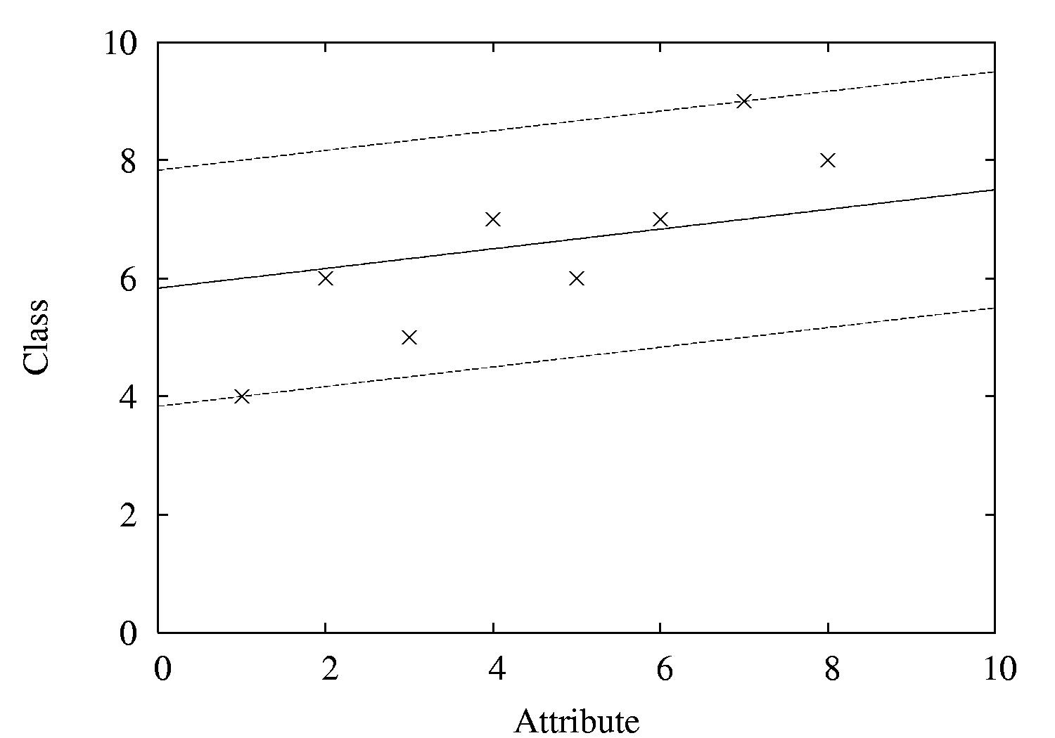
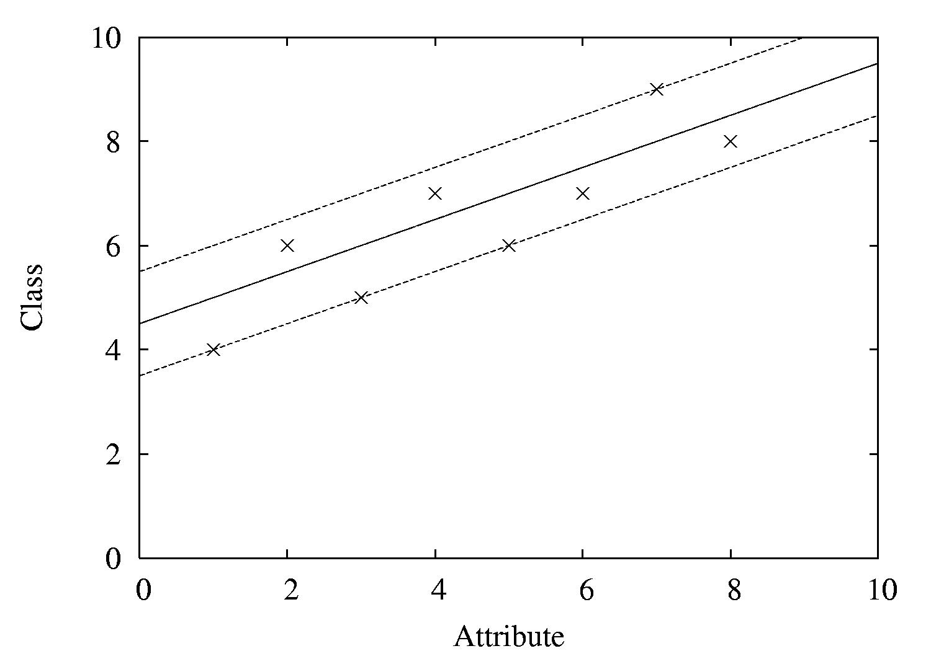
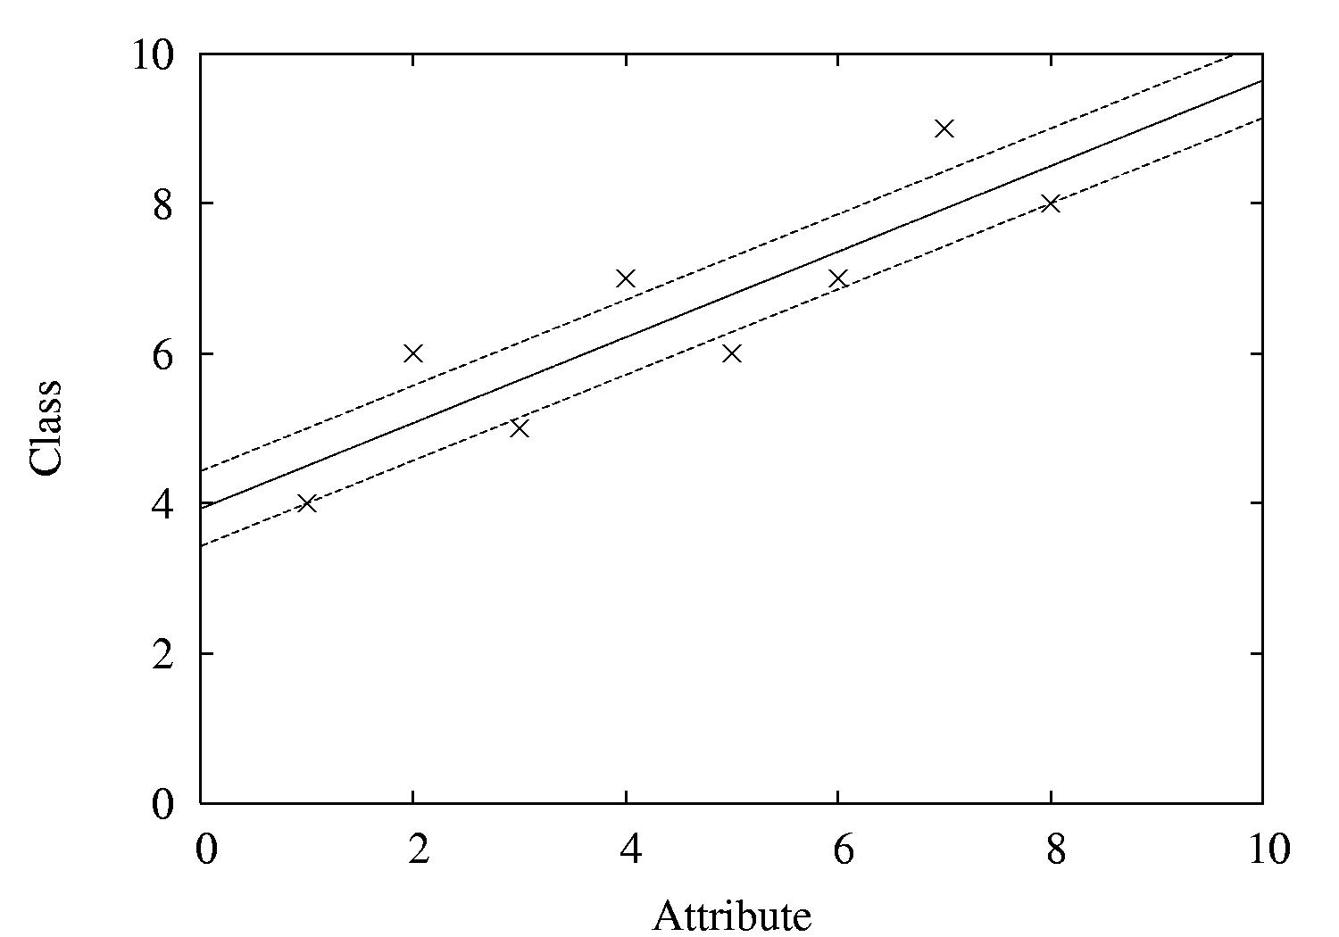
Examples
ε = 2
ε = 1
ε = 0.5
Notes:
4/16/2020
28
28

Slide 29
Kernel Ridge Regression
For classic linear regression using squared loss, only simple matrix operations are needed to find the parameters
This is not the case for support vector regression because a different loss function is used
Requires use of numeric optimization technique such as sequential minimal optimization
Can we combine the power of the kernel trick with the simplicity of standard least-squares regression?
Yes! This yields kernel ridge regression
Notes:
4/16/2020
29
29

Slide 30

Comments on kernel ridge regression
Like in an SVM, the predicted class value for a test instance is expressed as a weighted sum of dot products
But: all training instances are involved in this sum:
Unlike in an SVM, all training instances participate – not just support vectors
No sparseness in the solution (no support vectors)
Also, loss in ridge regression does not ignore errors smaller than ε
Moreover, squared error is used instead of absolute error so regression model is more sensitive to outliers
Notes:
4/16/2020
30
30

Slide 31
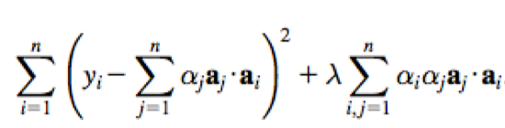
Performing kernel ridge regression
The penalized loss function that is optimized by kernel ridge regression is
The user-specified parameter λ determines closeness of fit to the training data
The coefficients can be found using matrix operations
Standard regression – invert an m × m matrix (O(m³)), m = #attributes
Kernel ridge regression – invert an n × n matrix (O(n³)), n = #instances
Has an advantage if
a non-linear fit is desired or
there are more attributes than training instances
Notes:
4/16/2020
31
31

Slide 32
The kernel perceptron
We can use the “kernel trick” to make a non-linear classifier using the perceptron learning rule
Observation: in perceptron learning rule, weight vector is modified by adding or subtracting training instances
Hence, we can represent the learned weight vector using all instances that have been misclassified:
This means we can use instead of ( where y’s are either -1 or +1)
Now swap summation signs:
Can be expressed as:
Can replace dot product by kernel:
Notes:
4/16/2020
32
32

Slide 33
Comments on kernel perceptron
Finds separating hyperplane in space created by kernel function (if it exists)
But: doesn’t necessarily find maximum-margin hyperplane
Easy to implement, supports incremental learning
Perceptron can be made more stable by using all weight vectors encountered during incremental learning, not just the last one (yields the voted perceptron)
Weight vectors vote on prediction (vote based on number of successful classifications since inception)
Notes:
4/16/2020
33
33

Slide 34
Multilayer perceptrons
Using kernels is only one way to build nonlinear classifier based on perceptrons
Can create network of perceptrons to approximate arbitrary target concepts
A multilayer perceptron is an example of an artificial neural network build from perceptrons
Consists of: input layer, hidden layer(s), and output layer
Structure of MLP is usually found by experimentation
Parameters can be found using backpropagation
Notes:
4/16/2020
34
34

Slide 35
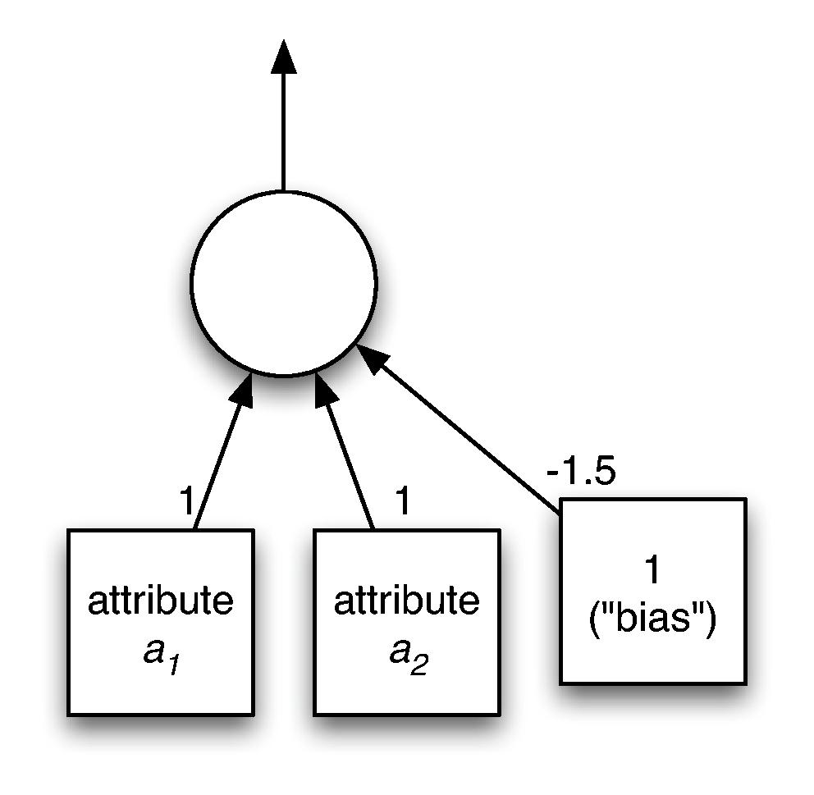
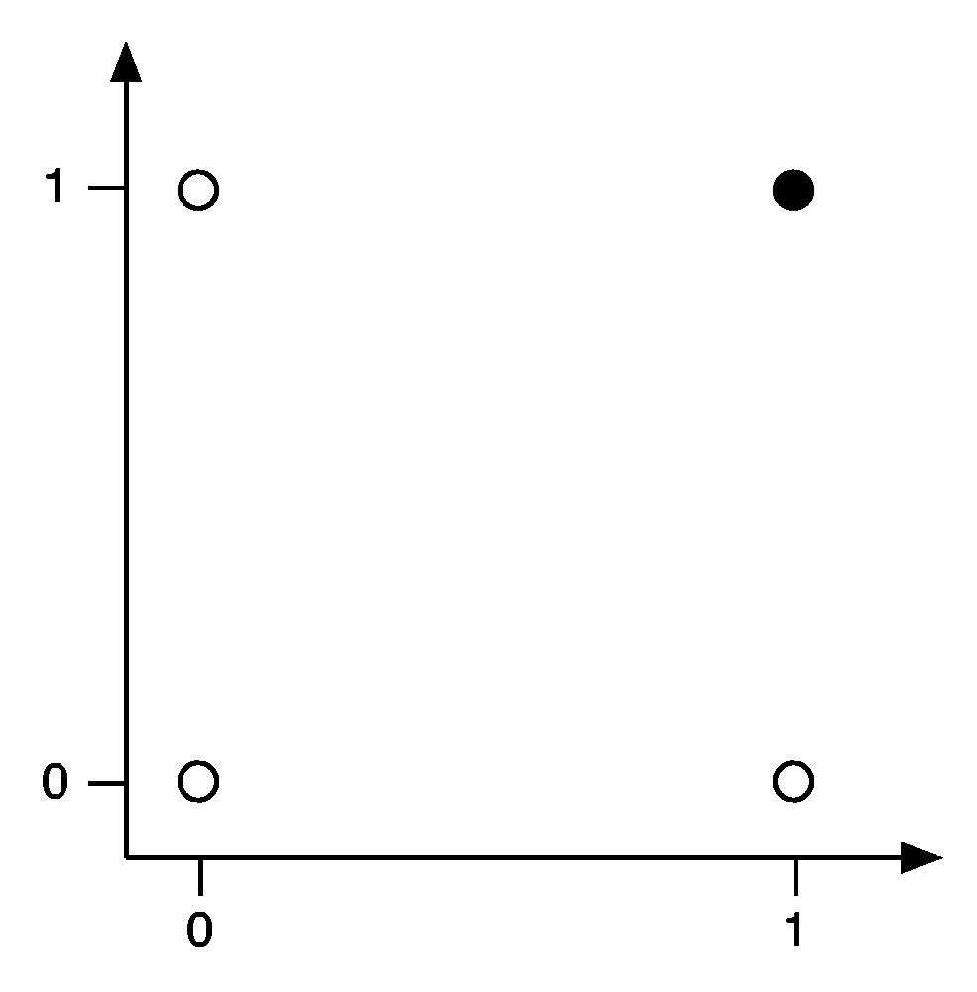
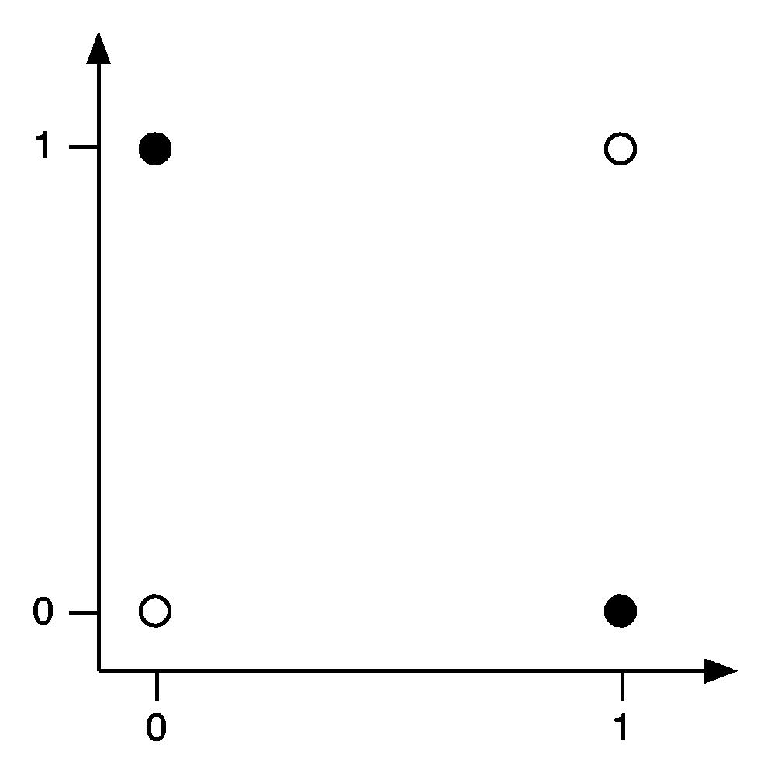

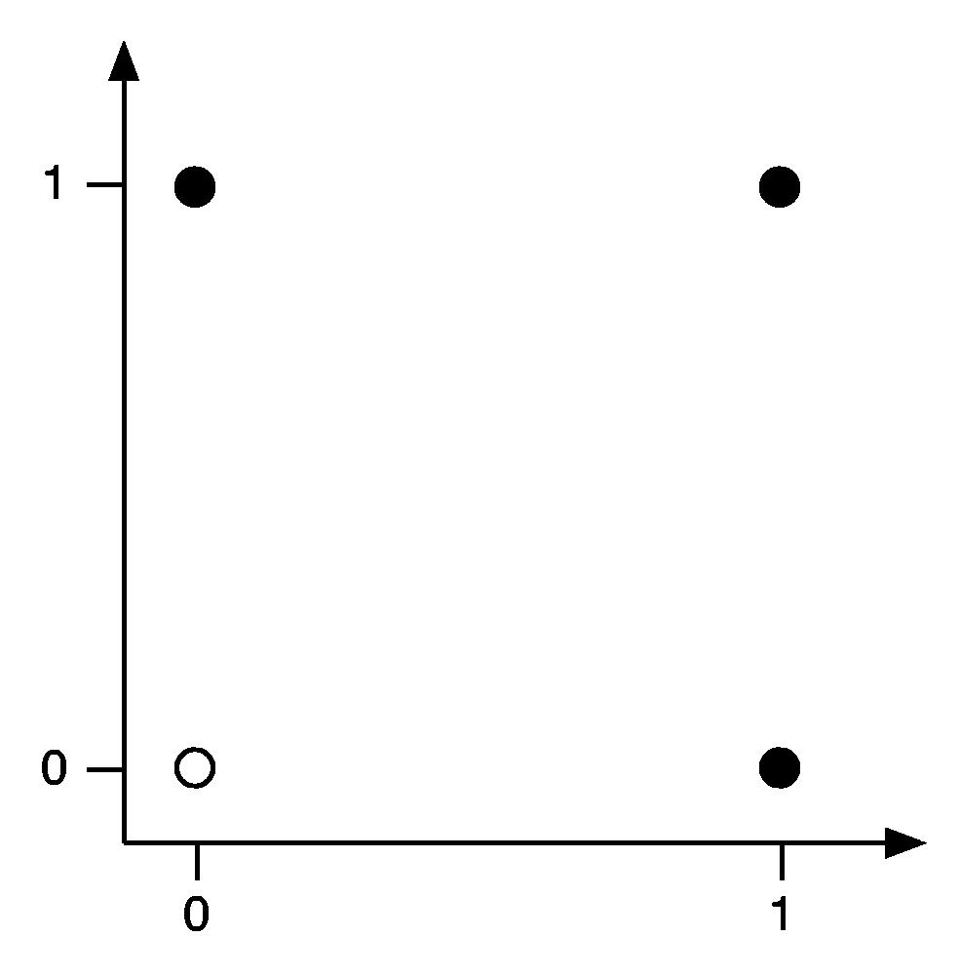
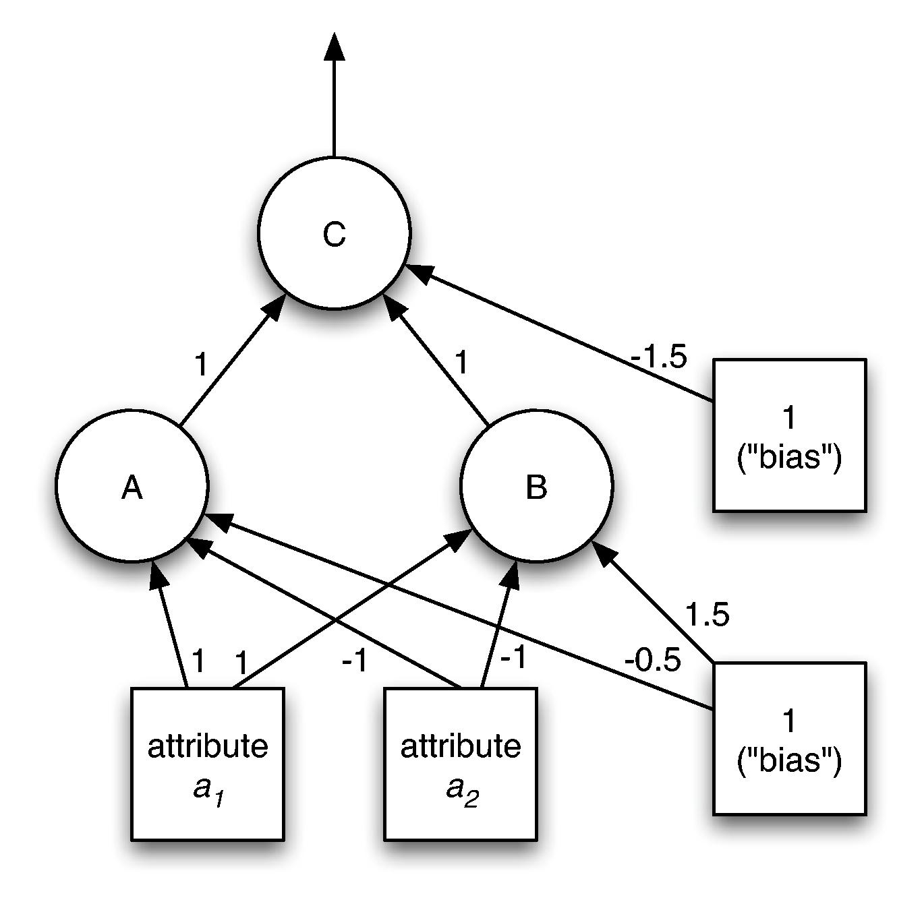
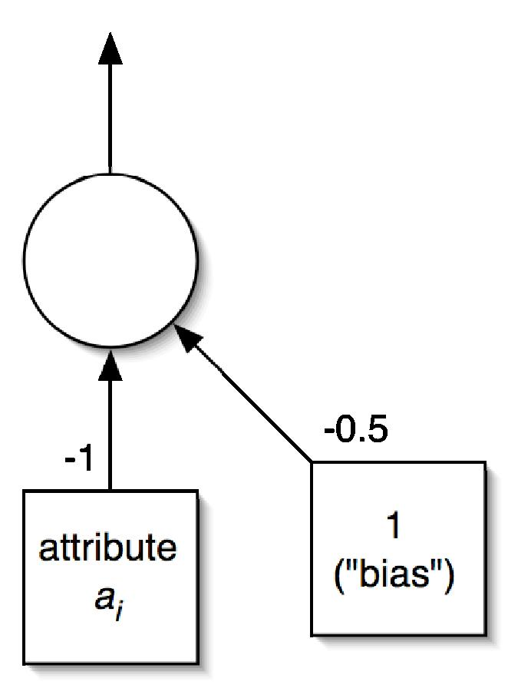
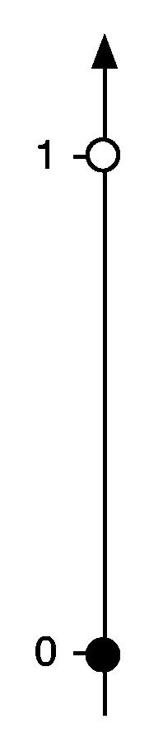
Examples
Notes:
4/16/2020
35
35

Slide 36
Backpropagation
How to learn the weights given a network structure?
Cannot simply use perceptron learning rule because we have hidden layer(s)
Function we are trying to minimize: error
Can use a general function minimization technique called gradient descent
Activation function needs to provide gradient information: can use sigmoid function instead of threshold (step) function
Loss function also needs to provide gradient information: cannot use zero-one loss, but can use squared error
Notes:
4/16/2020
36
36

Slide 37
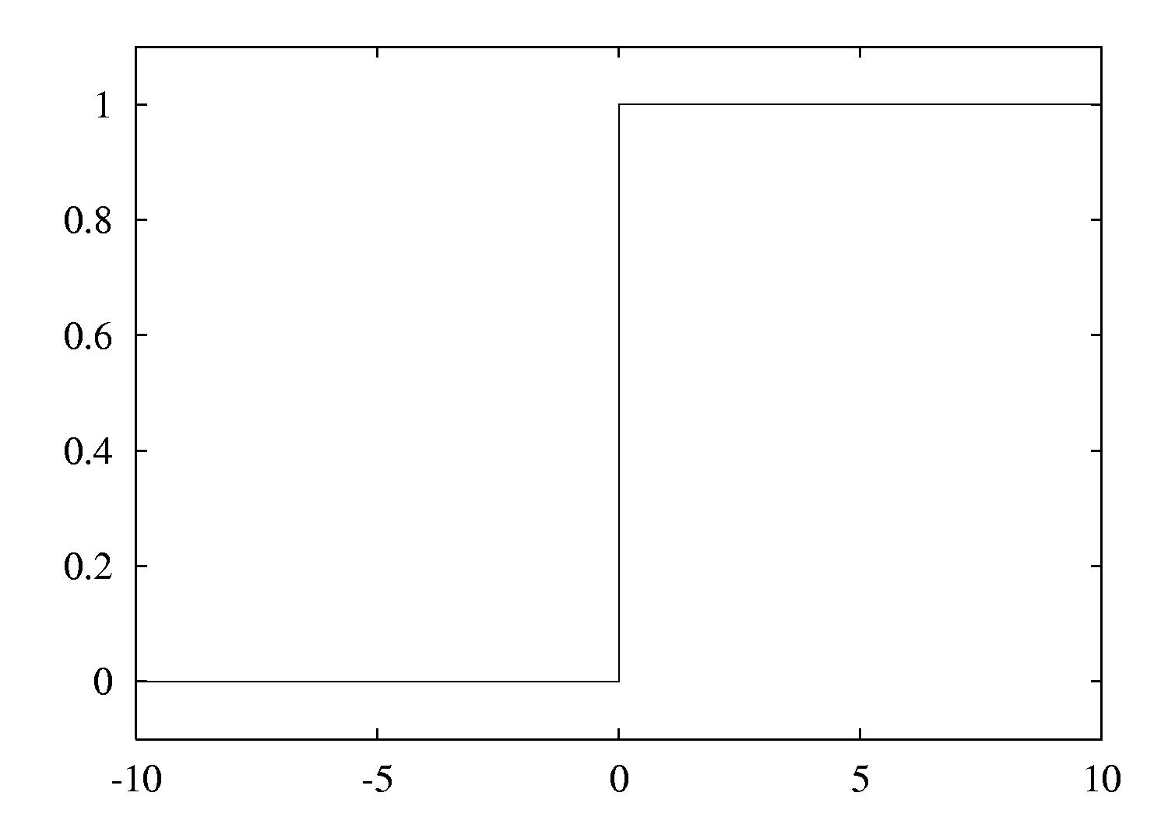
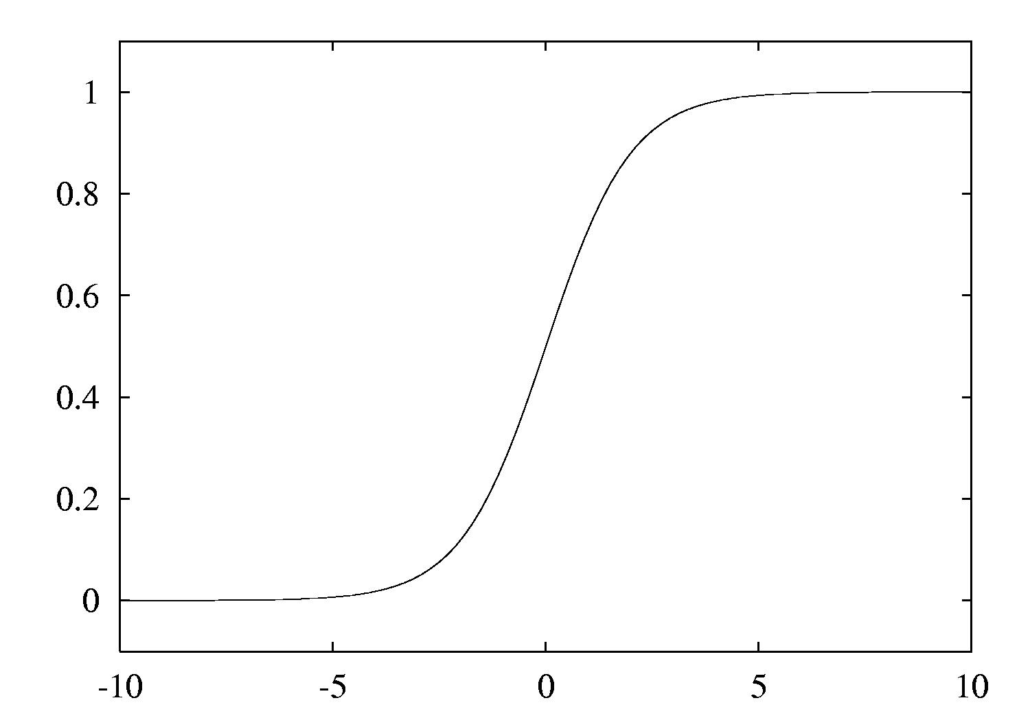
Threshold vs. sigmoid activation function
Notes:
4/16/2020
37
37

Slide 38
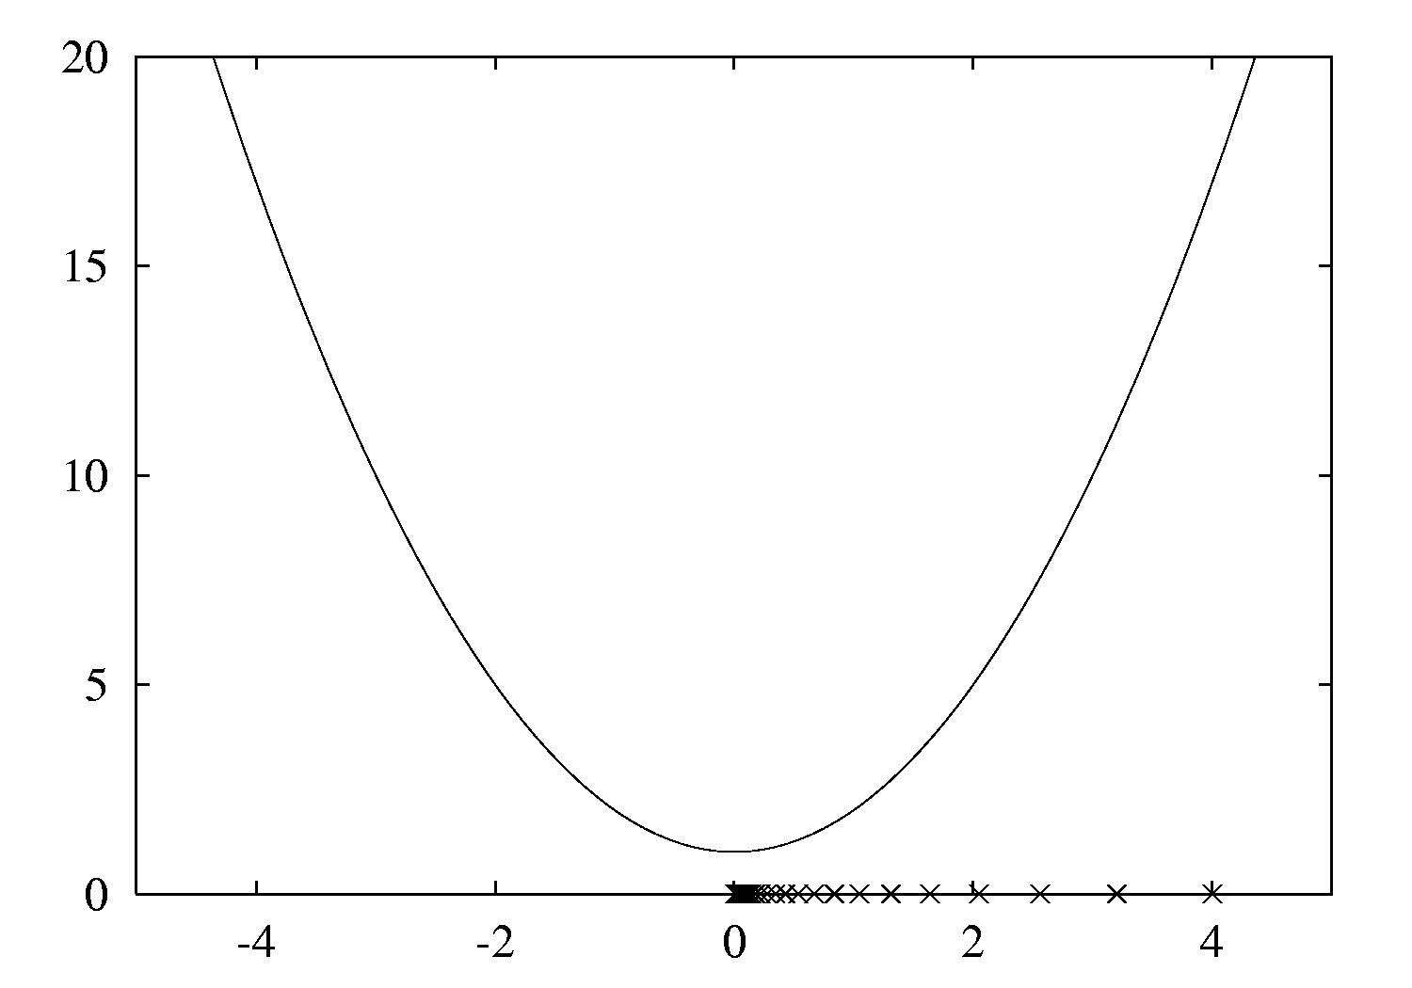
Gradient descent example
Function: x²+1
Derivative: 2x
Learning rate: 0.1
Start value: 4
First step: 2*4*0.1 = 0.8
Next value: 4 – 0.8 = 3.2
Second step: 2*3.2*0.1 = 0.64
Next value: 3.2 – 0.64 = 2.56
Can only find a local minimum!
Notes:
4/16/2020
38
38

Slide 39
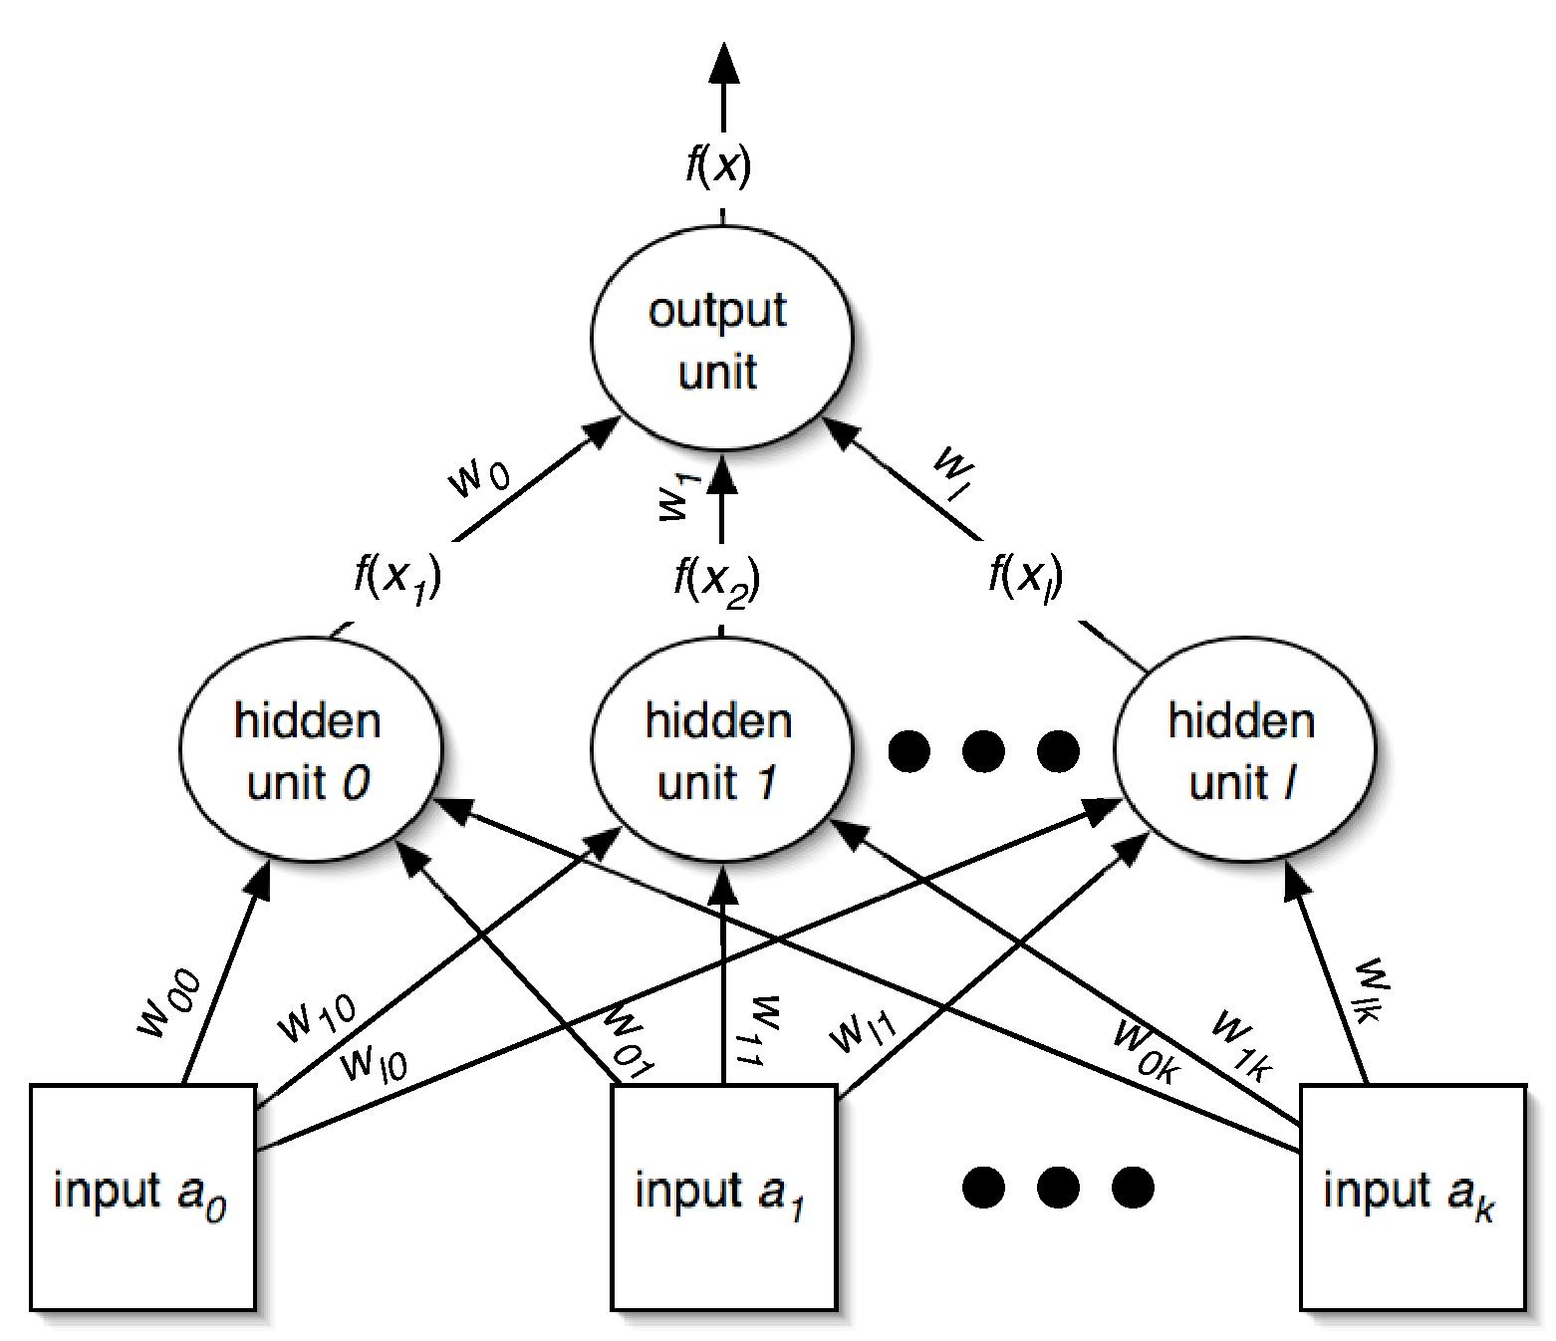
Minimizing the error I
Need to find partial derivative of error function with respect to each parameter (i.e., weight):
Notes:
4/16/2020
39
39

Slide 40
Minimizing the error II
What about the weights for the connections from the input to the hidden layer? More application of the chain rule…
Notes:
4/16/2020
40
40

Slide 41
Remarks
The same process works for multiple hidden layers and multiple output units (e.g., for multiple classes)
Can update weights after all training instances have been processed or incrementally:
batch learning vs. stochastic backpropagation
Weights are initialized to small random values
How to avoid overfitting?
Early stopping: use validation set to check when to stop
Weight decay: add penalty term to error function
How to speed up learning?
Momentum: re-use proportion of old weight change
Use optimization method that employs 2nd derivative
Notes:
4/16/2020
41
41

Slide 42

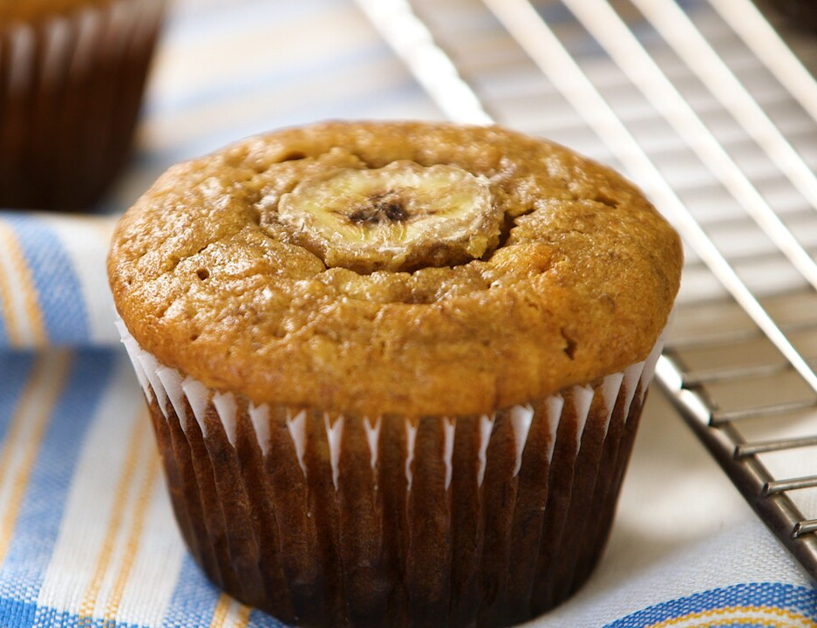
MLP in Practice
Can be used for:
Regression problems
Classification problems
Could be used for, for example, image recognition but has been surpassed by other approaches such as CNN
Example Image Classification: Chihuahua OR Muffin?
Easy?
vs.
https://unsplash.com/photos/dIb_TIjZ80A
https://www.marthastewart.com/345534/banana-muffins
Notes:
4/16/2020
42
42

Slide 43
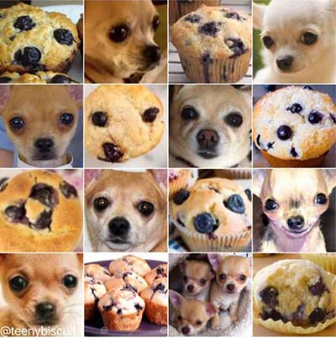
Image Classification: Chihuahua or Muffin??
Not always easy…
Original source: https://twitter.com/teenybiscuit
Notes:
4/16/2020
43
43

Slide 44
Radial basis function networks
RBF network: another type of feedforward network, with two layers (plus the input layer)
Hidden units represent points in instance space and activation depends on distance to these points
To this end, distance is converted into a similarity score using a Gaussian activation function
Width of Gaussian may be different for each hidden unit
Points of equal activation of units in hidden layer form hypersphere (or hyperellipsoid) as opposed to hyperplane
Output layer is the same as in a multi-layer perceptron
Notes:
4/16/2020
44
44

Slide 45
Learning RBF networks
Parameters to be learned: centers and widths of the RBFs + weights in output layer
Can learn the two sets of parameters independently and still get fairly accurate models
E.g.: clusters from k-means can be used to form basis functions
Linear model for output layer can be based on fixed RBFs found using clustering, which makes learning very efficient
However, for best accuracy it is best to train the entire network in a fully supervised manner
Can use the same methods that are used for training multilayer perceptrons
Disadvantage of standard RBF networks: no built-in attribute weighting based on relevance
But: can introduce attribute weights into the distance function
RBF networks are related to RBF SVMs, which have a basis function centered on each support vector
Notes:
4/16/2020
45
45

Slide 46
Stochastic gradient descent
We have seen gradient descent + backpropagation for learning weights in a neural network
Gradient descent is a general-purpose optimization technique
Can be applied whenever the objective function is differentiable
Actually, can be used even when the objective function is not completely differentiable!
This based on the concept of subgradients, which we will not get into here
One application: learning linear models – e.g. linear SVMs or logistic regression
Very fast, simple method for learning from large datasets
Notes:
4/16/2020
46
46

Slide 47
Stochastic gradient descent cont.
Learning linear models using gradient descent is easier than optimizing non-linear neural networks
Objective function has a single global minimum rather than several local minima
Stochastic gradient descent is fast, uses little memory and is suitable for incremental online learning
Let us look at how to apply stochastic gradient descent to learn a linear support vector machine
Notes:
4/16/2020
47
47

Slide 48
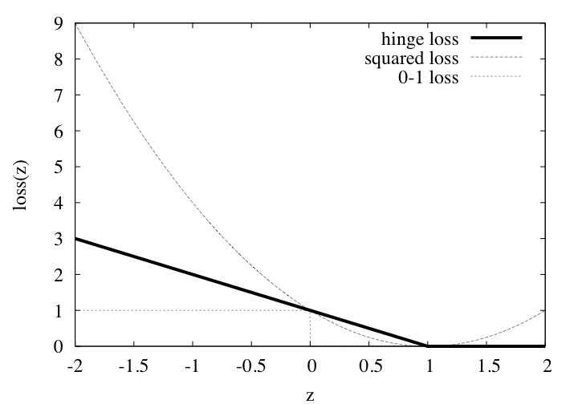
Loss functions
For SVMs, the error function (to be minimized) is called the hinge loss
Notes:
4/16/2020
48
48

Slide 49
Optimizing the hinge loss
In the linearly separable case, the hinge loss is 0 for a function that successfully separates the data
The maximum margin hyperplane is given by the smallest weight vector that achieves 0 hinge loss
Corresponding optimization problem that needs to be solved:
But: hinge loss is not differentiable at z = 1; cannot compute gradient for all values of z
Can use subgradient – something that resembles a gradient
Can use 0 at z = 1
In fact, loss is 0 for z ≥ 1, so we can focus on z < 1 and proceed as usual with stochastic gradient descent
Also yields a solution if the data is not separable
user-specified
regularization
parameter
z
Notes:
4/16/2020
49
49

Slide 50
Discussion and Bibliographic Notes
SVMs stem from statistical learning theory (Vapnik 1999)
A good starting point for exploration is a tutorial by Burges (1998)
Soft-margin SVMs were discussed by Cortes and Vapnik (1995)
Tutorial on support vector regression: Smola and Schölkopf (2004)
Schölkopf et al. (1999) present support vector regression with just one parameter instead of two (C and ε)
Fletcher (1987) covers constrained quadratic optimization
The SMO algorithm for training SVMs is due to Platt (1998)
Ridge regression was introduced by Hoerl and Kennard (1970)
Hastie et al. (2009) give a good description of kernel ridge regression
Kernel ridge regression is equivalent to Gaussian process regression, a Bayesian approach that also provides estimates of uncertainty

Slide 51
Discussion and Bibliographic Notes
The kernel perceptron is due to Freund and Schapire (1999)
Cristianini and Shawe-Taylor (2000) provide an introduction to support vector machines and kernel-based methods
Shawe-Taylor and Cristianini (2004) and Schölkopf and Smola (2002) cover kernel-based learning in detail
Bishop (1995) provides an excellent introduction to both multilayer perceptrons and RBF networks
Kivinen et al. (2002), Zhang (2004) and Shalev-Shwartz et al. (2007) explore gradient methods for SVMs
Kivinen et al. and Shalev-Shwartz et al. provide heuristics for setting the learning rate for gradient descent

Slide 52
Numeric Prediction with Local Linear Models

Slide 53
Numeric prediction (aka regression)
Counterparts exist for all classification schemes previously discussed
Decision trees, rule learners, SVMs, etc.
(Almost) all classification schemes can be applied to regression problems using discretization:
Discretize the output interval into classess
Predict weighted average of interval representatives (e.g., midpoints)
Weight according to class probabilities
We will cover a couple of approaches to regression that are based on building local linear models
Model trees (+ a rule learning algorithm based on them) and locally weighted linear regression
Notes:
4/16/2020
53
53

Slide 54
Regression trees
Like decision trees, but:
Splitting criterion: minimize intra-subset variation
Termination criterion: std. dev. becomes small
Pruning criterion: based on numeric error measure
Prediction: Leaf predicts average class value of instances
Yields piecewise constant functions
Easy to interpret
More sophisticated version: model trees
Notes:
4/16/2020
54
54

Slide 55
Model trees
Build a regression tree
Each leaf ⇒ linear regression function
Smoothing: factor in ancestor’s predictions
Smoothing formula:
Same effect can be achieved by incorporating ancestor models into the leaves
Need linear regression function at each node
At each node, use only a subset of attributes to build linear regression model
Those occurring in subtree
(+maybe those occurring in path to the root)
Fast: tree usually uses only a small subset of the attributes
Notes:
4/16/2020
55
55

Slide 56
Building the tree
Splitting: standard deviation reduction
Termination of splitting process:
Standard deviation < 5% of its value on full training set
Too few instances remain (e.g., < 4)
Pruning:
Heuristic estimate of absolute error of linear regression models:
Greedily remove terms from LR models to minimize estimated error
Proceed bottom up: compare error of LR model at internal node to error of subtree (this happens before smoothing is applied)
Heavy pruning: single model may replace whole subtree
Notes:
4/16/2020
56
56

Slide 57
Nominal attributes
Convert nominal attributes to binary ones
Sort attribute values by their average class values (over training instances)
If attribute has k values, generate k – 1 binary attributes
i th attribute is 0 if original nominal value is part of the first i nominal values in the sorted list, and 1 otherwise
Treat binary attributes as numeric in linear regression models and when selecting splits
Can prove: best SDR split on one of the new binary attributes is the best (binary) SDR split on original nominal attribute
In practice this process is not applied at every node of the tree but globally at the root node of the tree
Splits are no longer optimal but runtime and potential for overfitting are reduced this way
Notes:
4/16/2020
57
57

Slide 58
Missing values
Modify splitting criterion:
To determine which branch an instance with missing value goes down, use surrogate splitting
Split on the attribute whose correlation with attribute whose value is missing is greatest
Problem: complex and time-consuming
Simple solution: always use the class as surrogate attribute
Class can only be used at training time
Test set: replace missing value with average value for attribute
Notes:
4/16/2020
58
58

Slide 59
Surrogate splitting based on class
Choose split point based on instances with known values
Split point divides instances into 2 branches/subsets
L (smaller class average)
R (larger)
m is the average of the two average class values for L and R
For an instance with a missing value:
Choose L if class value < m
Otherwise R
Once full tree is built, replace missing values with averages of corresponding leaf nodes
Linear regression models can then be built on the completed (“imputed”) dataset
Notes:
4/16/2020
59
59

Slide 60
Pseudo-code for M5'
Let us consider the pseudo code for the model tree inducer M5’
Four methods:
Main method: MakeModelTree
Method for splitting: split
Method for pruning: prune
Method that computes error: subtreeError
We will briefly look at each method in turn
We will assume that the linear regression method performs attribute subset selection based on error (discussed previously)
Nominal attributes are replaced globally at the root node
Notes:
4/16/2020
60
60

Slide 61
MakeModelTree
MakeModelTree (instances)
{
SD = sd(instances)
for each k-valued nominal attribute
convert into k-1 synthetic binary attributes
root = newNode
root.instances = instances
split(root)
prune(root)
printTree(root)
}
Notes:
4/16/2020
61
61

Slide 62
split
split(node)
{
if sizeof(node.instances) < 4 or
sd(node.instances) < 0.05*SD
node.type = LEAF
else
node.type = INTERIOR
for each attribute
for all possible split positions of attribute
calculate the attribute's SDR
node.attribute = attribute with maximum SDR
split(node.left)
split(node.right)
}
Notes:
4/16/2020
62
62

Slide 63
prune
prune(node)
{
if node = INTERIOR then
prune(node.leftChild)
prune(node.rightChild)
node.model = linearRegression(node)
if subtreeError(node) > error(node) then
node.type = LEAF
}
Notes:
4/16/2020
63
63

Slide 64
subtreeError
subtreeError(node)
{
l = node.left; r = node.right
if node = INTERIOR then
return (sizeof(l.instances)*subtreeError(l)
+ sizeof(r.instances)*subtreeError(r))
/sizeof(node.instances)
else return error(node)
}
Notes:
4/16/2020
64
64

Slide 65
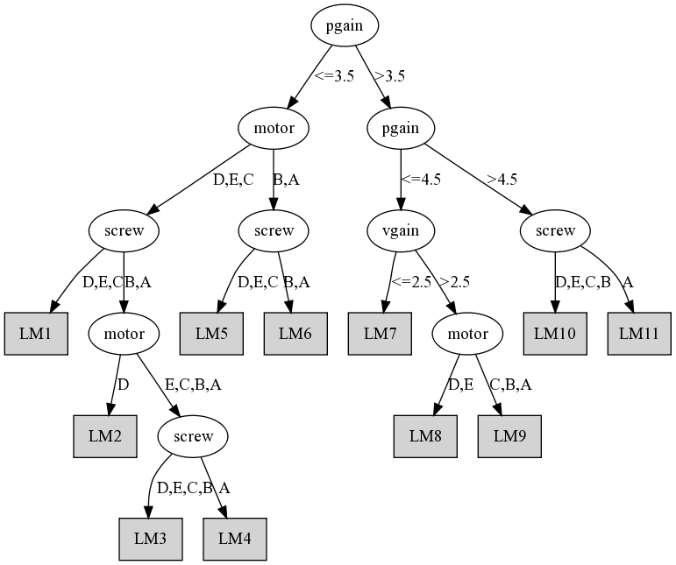
Model tree for servo data
Notes:
4/16/2020
65
65

Slide 66
Rules from model trees
PART algorithm generates classification rules by building partial decision trees
Can use the same method to build rule sets for regression
Use model trees instead of decision trees
Use variance instead of entropy to choose node to expand when building a partial tree
Rules that are generated will have linear models on right-hand side
Caveat: using smoothed trees may not be appropriate due to the separate-and-conquer strategy used in rule learning
Empirical evidence shows that smoothing does not help
Full trees can be used instead of partial trees at the expense of runtime
Notes:
4/16/2020
66
66

Slide 67
Locally weighted regression
Locally weighted regression is a numeric prediction method that combines
instance-based learning
linear regression
It is a “lazy” learning method:
Computes new regression function for each test instance at prediction time
Works incrementally
Weights training instances
according to distance to test instance
builds linear regression model from weighted data
requires weighted version of linear regression (straightforward)
Advantage: nonlinear approximation
Slow if implemented using brute-force search; however, fast data structures can be used for the nearest-neighbor search
Notes:
4/16/2020
67
67

Slide 68
Design decisions
Weighting functions:
Inverse Euclidean distance
Gaussian kernel applied to Euclidean distance
Triangular kernel used the same way
etc.
Empirically, performance does not appear to depend much on the weighting method that is used
Ideally, weighting function has bounded support so that most training instances receive weight 0 and can be ignored
Smoothing parameter is used to scale the distance function for computation of the weights
Multiply distance by inverse of this parameter
Possible choice: distance to the kth nearest training instance (renders choice of smoothing parameter data dependent)
Notes:
4/16/2020
68
68

Slide 69
Discussion and Bibliographic Notes
Regression trees were introduced in the “classification and regression trees”, or CART system (Breiman et al., 1984)
The method of handling nominal attributes and the surrogate device for dealing with missing values were included in CART
M5 model trees were first described by Quinlan (1992)
The M5’ version is given by Wang and Witten (1997)
Using model trees (although not partial trees) for generating rule sets has been explored by Hall et al. (1999)
There are many variations of locally weighted learning.
Statisticians have considered using locally quadratic models
They have applied locally weighted logistic regression to classification
Frank et al. (2003) evaluated the use of locally weighted learning in conjunction with Naïve Bayes
Atkeson et al. (1997) provide a survey on locally weighted learning

